Slide 1
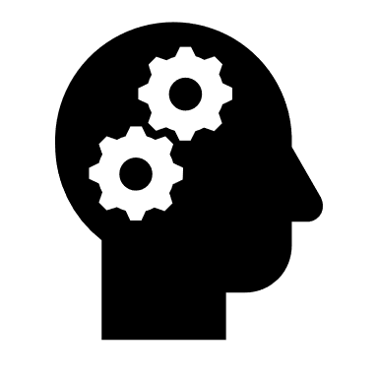

Kidney Disease Prediction Using Artificial Neural Networks
Sai Sheshank Gaddam

Slide 2
Abstract
A global health problem which is steadily growing is Chronic kidney disease (CKD). It is a chronic condition associated with increased morbidity and mortality, a high risk of many other diseases including cardiovascular disease, and high health care costs.

Slide 3
Objective
This project is aimed at developing a model which predicts whether a person is affected by kidney disease based on certain parameters, demonstrates a promising capability of reducing the uncertainties in the prediction model. Accurate and reliable disease predictions are necessary to the people in need.

Slide 4
Introduction
The main initiate of this project is to reduce manual work. To develop this type of project the person should have well knowledge of python using deep learning techniques mainly Artificial neural networks because the approach used for our project is ANN. We have taken 24 inputs from blood tests and urine test to predict the outcome.

Slide 5
Problem Definition
There is significant importance in the early detection, controlling, and managing of the disease. It is necessary to predict the progression of CKD with reasonable accuracy because of its dynamic and covert nature in the early stages, and patient heterogeneity. CKD is often described by severity stages. Clinical decisions are influenced by the stage, whether a patient is progressing, and the rate of progression. Also, defining the disease stage is quite crucial as it gives several indications that support the determination of required intervention and treatments.

Slide 6
Proposed Work
A large sample of 400 patients data set is taken in which there are 24 independent attributes, related to blood test samples and one dependent attribute which classifies whether the person is affected by kidney disease or not! Now, our work is to apply Deep Learning Algorithm and predict the disease Analysis for other patients based on same parameters.

Slide 7
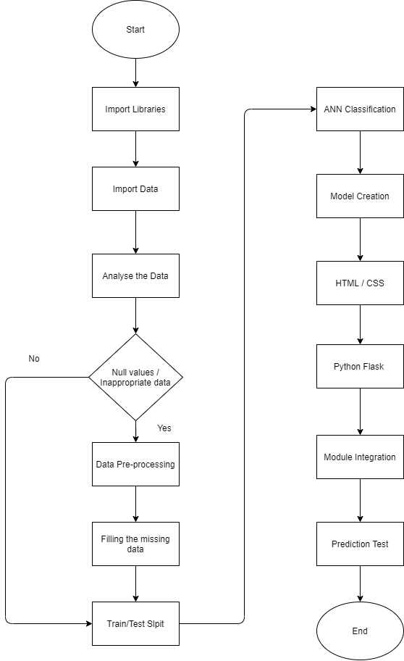
Work Flow

Slide 8
Description
AI plays a major role in extracting hidden data from the large patient medical and clinical dataset that physicians frequently collect from patients to obtain insights about the diagnostic information, and to implement precise treatment plans. Artificial Intelligence can be defined as the process of extracting hidden data from a large dataset. Deep Learning techniques are applied and used widely in various contexts and fields. With ANN technique we could predict, classify, filter and predict data.

Slide 9
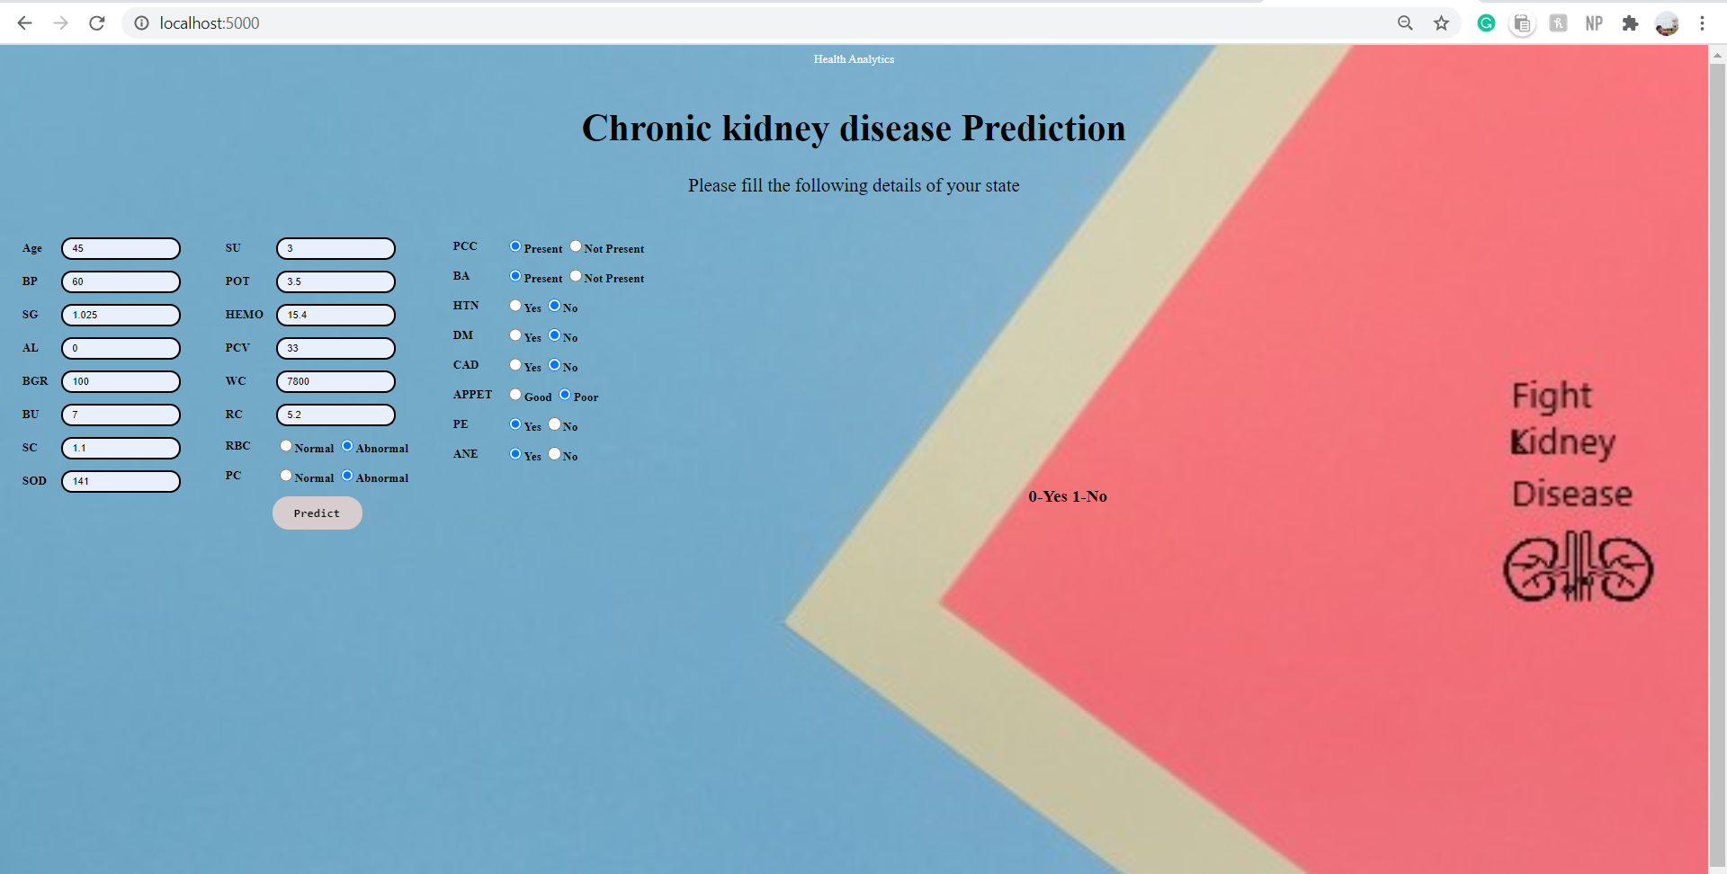
Results & Discussion

Slide 10
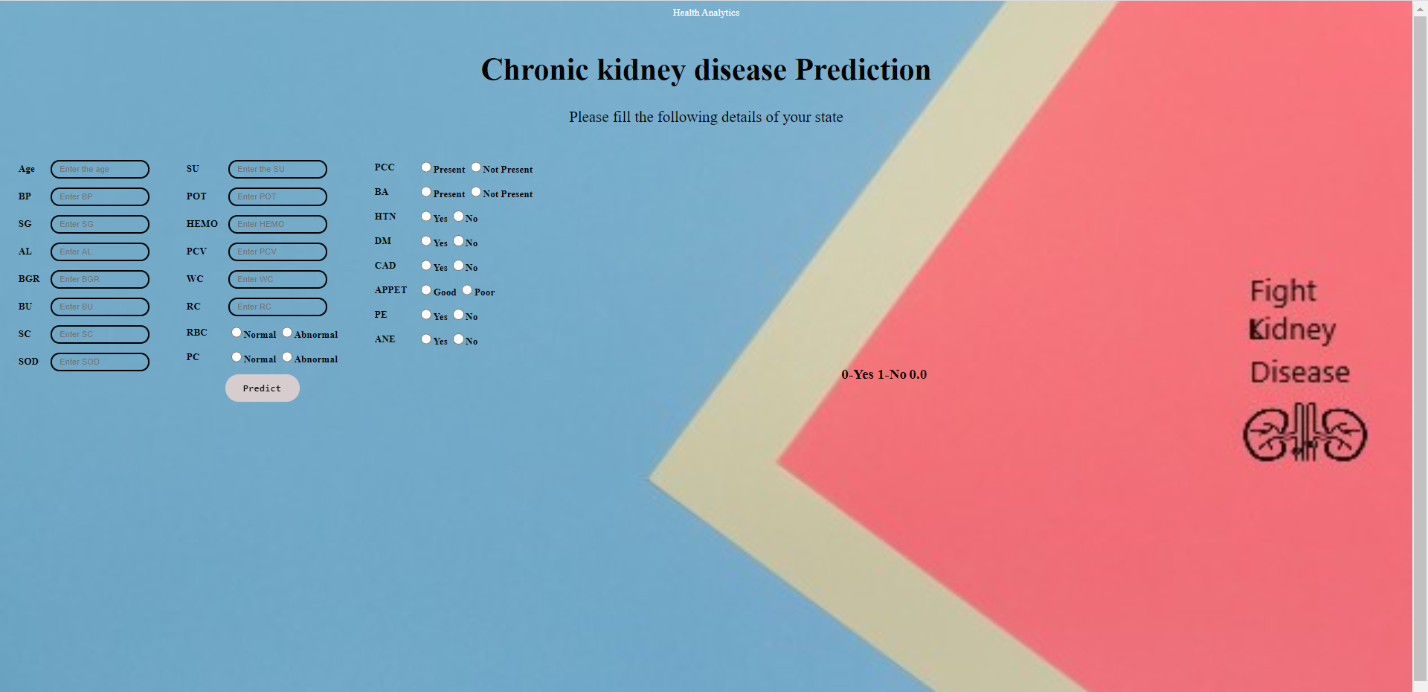
Cont…
The predicted value is displayed beside.

Slide 11
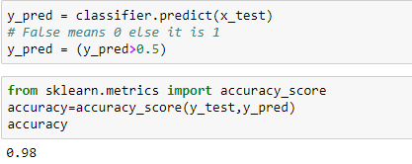
Cont…
Since our model accuracy is 98%. It means that our model predicts whether the person is affected by kidney disease with the probability of 0.98.

Slide 12
Conclusion
We developed this project using python3.
By taking the dataset we evaluated with different models and checked the accuracy for which model we can get maximum percentage so that particular model can be sustained and taken as good model.

Slide 13
Future Work
We could take this project to higher levels after the good research and we’ll prepare a dataset so that we can even give the prescription for the patient according to his health condition and level of disease spread in his body.
Since, the upcoming patients data is also used to predict the disease analysis, we will try to add new data to our current dataset so as to make our model more accurate with high amount of data.

Slide 14
References
https://www.kaggle.com/mansoordaku/ckdisease
https://towardsdatascience.com/data-visualization-for-machine-learning-and-data-sciencea45178970be7
https://thesmartbridge.com/documents/spsaimldocs/Datapreprocessing.pdf
https://thesmartbridge.com/documents/spsaimldocs/Datapreprocessing.pdf
https://thesmartbridge.com/documents/spsaimldocs/Datapreprocessing.pdf
https://thesmartbridge.com/documents/spsaimldocs/FlaskML.pdf

Slide 15

The End

